Slide 1

CMPUT 328 - Fall 2019
Assignment 7:
Adversarial Attack on LeNet5

Slide 2
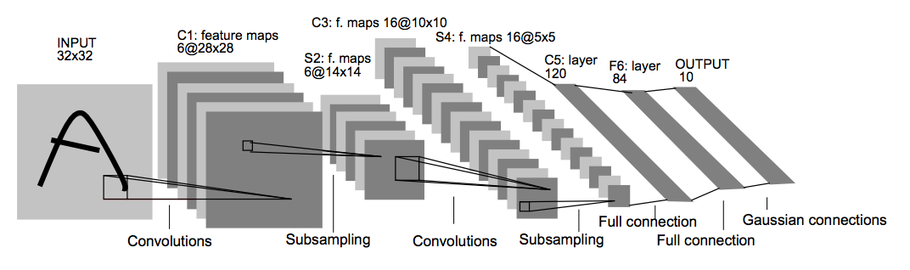
LeNet5 Architecture:
Given a pre-trained LeNet5 model, your job is to provide jpeg images to fool the network

Slide 3

Scenario 1
Make the network think that a random image belongs to a class with high confidence
Random image is characterized by having high Shannon entropy
High confidence is characterized by having a high predicted max probability
Notes:
Paramater sharing

Slide 4

Scenario 2
Make the network think that an image belongs to one class when it clearly belongs to another class
Submit a modified version of the first image in the test set of the MNIST dataset
Make the network think that it belongs to the 0 (zero) class
The modified image must have a high PSNR score (A larger PSNR indicates a higher degree of imperceptibility)
Notes:
Paramater sharing

Slide 5
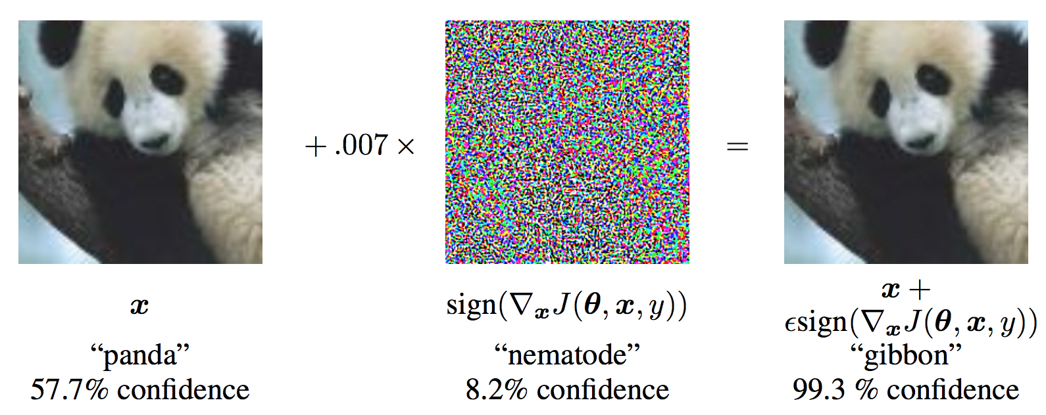
Fast Gradient Sign Attack (FGSM)
The attack uses the gradient of the loss w.r.t the input data, then adjusts the input data to maximize the loss.
x is the original input image
Y is the ground truth label for x
θ represents the model parameters
J(θ,x,y) is the loss that is used to train the network
perturbed_image= image + epsilon∗sign(data_grad) = x + ϵ∗sign(∇xJ(θ,x,y))
https://pytorch.org/tutorials/beginner/fgsm_tutorial.html
Notes:
Paramater sharing

Slide 6
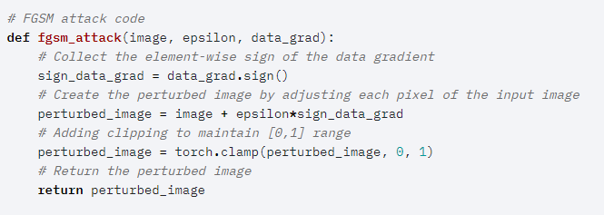
FGSM Attack
Notes:
To introduce non-linearty

Slide 7
Useful PyTorch functions:
grad.data
Data Loader : torchvision.datasets.MNIST
torch.clamp
torch.squeeze
Reference: https://pytorch.org/tutorials/beginner/fgsm_tutorial.html

